Slide 1
Some Statistical Methods for Multiplicity Issues in Clinical Trials
Presented by,
Saikiran Karra
Anjali Pandey

Slide 2
Agenda
Introduction
What is Multiplicity?
Regulatory guidelines
FWER
Types of endpoints (Backup Slide)

Slide 3
Agenda
Overview
Single step Procedures (Backup Slide)
Data-driven hypotheses ordering Procedures (Backup Slide)
Hierarchical Test Procedures
Power Analysis of hierarchical procedures using Simulation
Results
Key takeaways
Statistical methods for multiplicity adjustment

Slide 4
What is Multiplicity?
Multiplicity refers to the consideration of multiple comparisons (Post-hoc) or multiple tests within the same study.
When researchers conduct various analyses or comparisons, there is an increased likelihood of obtaining at least some statistically significant results by chance alone. This phenomenon is known as the problem of multiple comparisons.
When multiple hypotheses are tested without proper adjustment, the Type-I error and Family Wise Error Rate can become inflated, potentially leading to the approval of ineffective treatments.
Clinical trials in drug development often involve multiple comparisons due to assessment of multiple endpoints, different time points, multiple treatment arms and multiple interim analyses.

Slide 5

Regulatory guidelines
It incorporates info to ICH E9 Statistical Principles for Clinical Trials (1998).
Does not establish any legal constrain but provides the FDA thinking about the problem of having multiple endpoints in a clinical trial.
The purpose is to show some statistical methods to control the chance of making erroneous conclusions about a drug’s effects due to multiplicity.
https://www.fda.gov/regulatory-information/search-fda-guidance-documents/multiple-endpoints-clinical-trials-guidance-industry

Slide 6
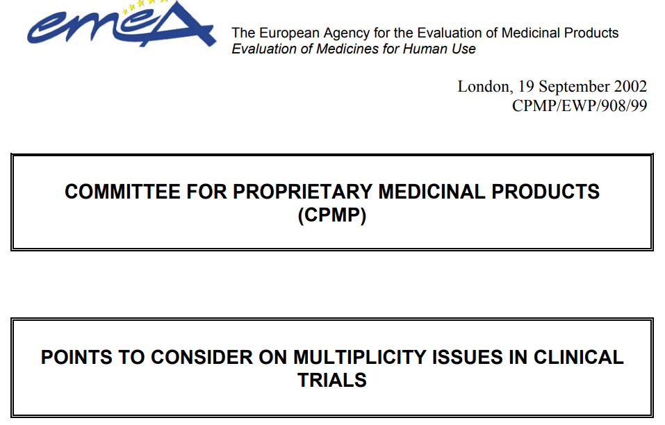
Regulatory guidelines
Points to consider on multiplicity issues in clinical trials (September 2002)
Draft guideline on multiplicity issues in clinical trials (April 2017)
https://www.ema.europa.eu/en/multiplicity-issues-clinical-trials-scientific-guideline

Slide 7
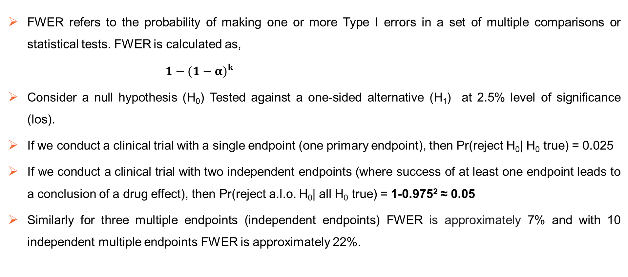
Family wise Error rate(FWER)
FWER refers to the probability of making one or more Type I errors in a set of multiple comparisons or statistical tests. FWER is calculated as,
${1−(1−α)}^{k}$
Consider a null hypothesis (H₀) Tested against a one-sided alternative (H₁) at 2.5% level of significance (los).
If we conduct a clinical trial with a single endpoint (one primary endpoint), then Pr(reject H₀| H₀ true) = 0.025
If we conduct a clinical trial with two independent endpoints (where success of at least one endpoint leads to a conclusion of a drug effect), then Pr(reject a.l.o. H₀| all H₀ true) = 1-0.975² ≈ 0.05
Similarly for three multiple endpoints (independent endpoints) FWER is approximately 7% and with 10 independent multiple endpoints FWER is approximately 22%.

Slide 8
Overview of the Multiplicity Adjustment Methods

Slide 9
Overview
Bonferroni Procedure
Sidak Procedure
Holm Step-Down Procedure
Hochberg Step-Up Procedure
Hommel Procedure
Single step
Non-/Semi Parametric Procedures
Multi step, data driven
Non-Hierarchical Hypotheses
Parametric Procedures
Dunnett Procedure (Single step)
Step-up Dunnett
Step-down Dunnett
Statistical methods for Multiplicity
Simple Procedures
Fixed Sequence Procedure
Fallback Procedure
Chain-based method
Hierarchical Hypotheses
Gatekeeping Procedures
Serial Gatekeeping Procedure
Parallel Gatekeeping Procedure
Multi Sequence Gatekeeping Procedure

Slide 10
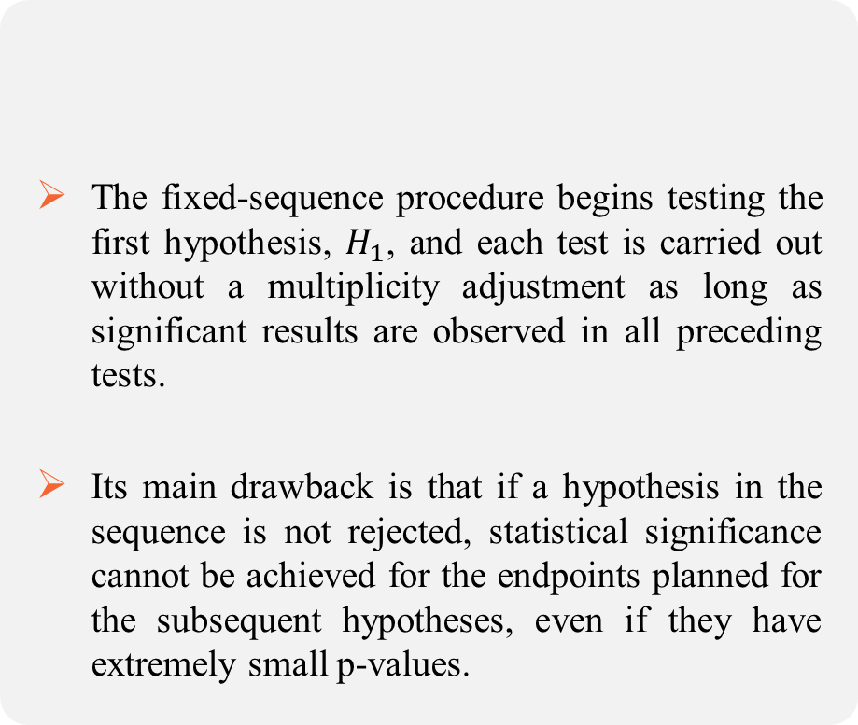
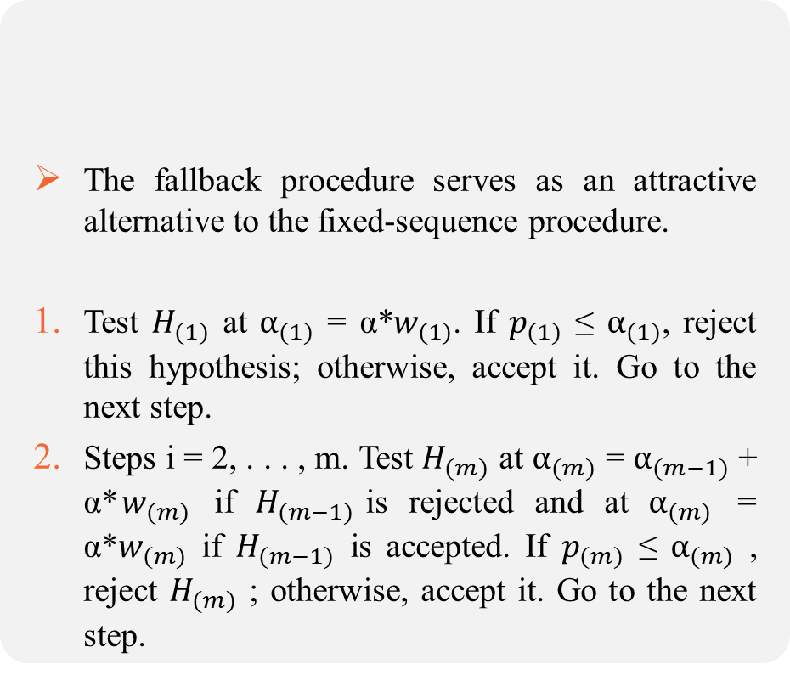
Hierarchical Multiplicity Adjustment Procedures
The fixed-sequence procedure begins testing the first hypothesis, $H_{1}$, and each test is carried out without a multiplicity adjustment as long as significant results are observed in all preceding tests.
Its main drawback is that if a hypothesis in the sequence is not rejected, statistical significance cannot be achieved for the endpoints planned for the subsequent hypotheses, even if they have extremely small p-values.
The fallback procedure serves as an attractive alternative to the fixed-sequence procedure.
Test $H_{(1)}$ at $α_{(1)}$ = α*$w_{(1)}$. If $p_{(1)}$ ≤ $α_{(1)}$, reject this hypothesis; otherwise, accept it. Go to the next step.
Steps i = 2, . . . , m. Test $H_{(m)}$ at $α_{(m)}$ = $α_{(m−1)}$ + α*$w_{(m)}$ if $H_{(m−1)}$is rejected and at $α_{(m)}$ = α*$w_{(m)}$ if $H_{(m−1)}$ is accepted. If $p_{(m)}$ ≤ $α_{(m)}$ , reject $H_{(m)}$ ; otherwise, accept it. Go to the next step.
Fixed Sequence Procedure
Fallback Procedure

Slide 11
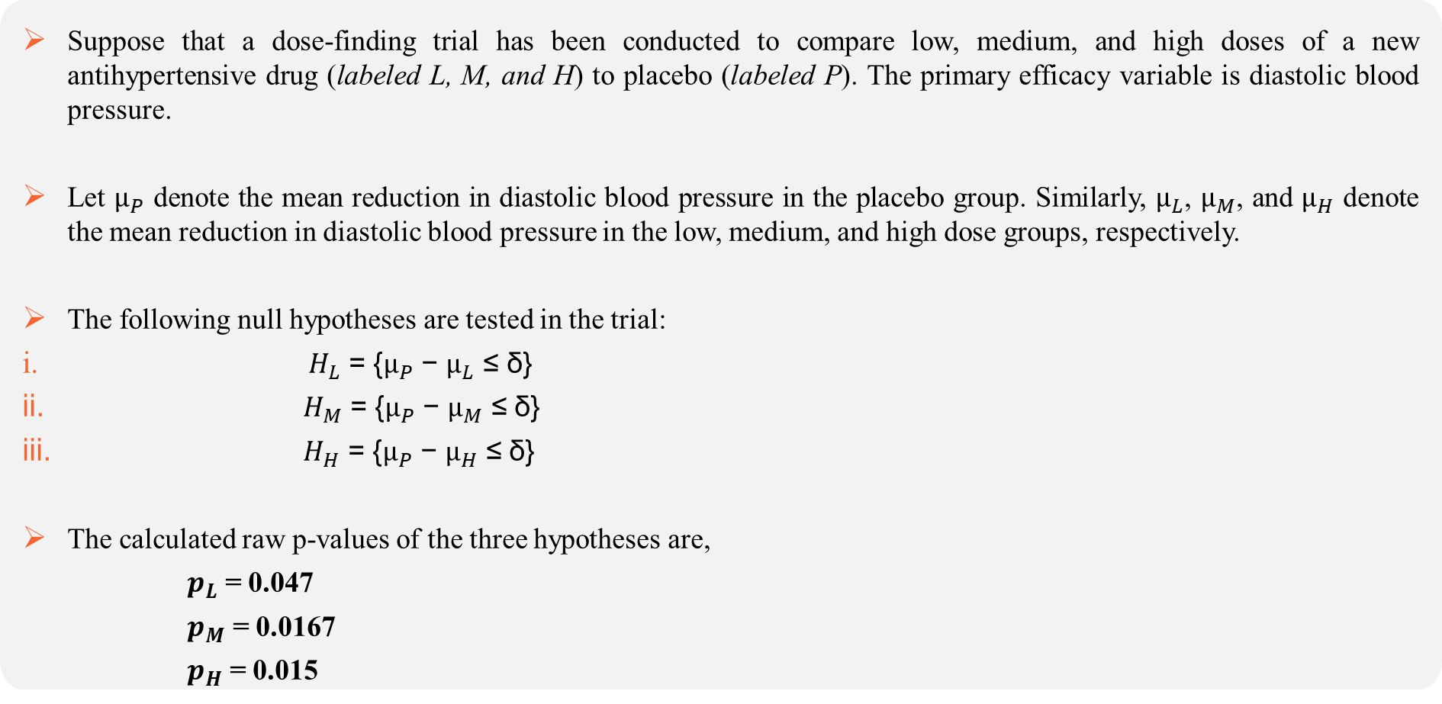
Example: Case Study (Dose finding hypertension trial)
Suppose that a dose-finding trial has been conducted to compare low, medium, and high doses of a new antihypertensive drug (labeled L, M, and H) to placebo (labeled P). The primary efficacy variable is diastolic blood pressure.
Let $μ_{P}$ denote the mean reduction in diastolic blood pressure in the placebo group. Similarly, $μ_{L}$, $μ_{M}$, and $μ_{H}$ denote the mean reduction in diastolic blood pressure in the low, medium, and high dose groups, respectively.
The following null hypotheses are tested in the trial:
$H_{L}$ = {$μ_{P}$ − $μ_{L}$ ≤ δ}
$H_{M}$ = {$μ_{P}$ − $μ_{M}$ ≤ δ}
$H_{H}$ = {$μ_{P}$ − $μ_{H}$ ≤ δ}
The calculated raw p-values of the three hypotheses are,
$p_{L}$ = 0.047
$p_{M}$ = 0.0167
$p_{H}$ = 0.015

Slide 12
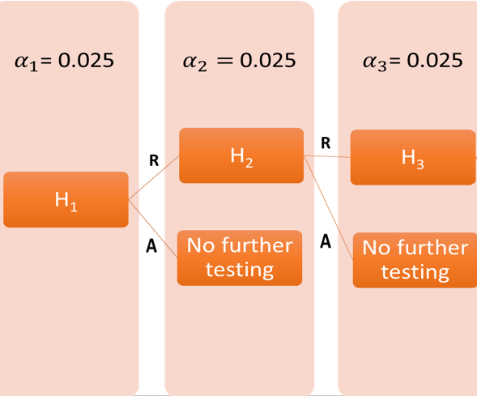
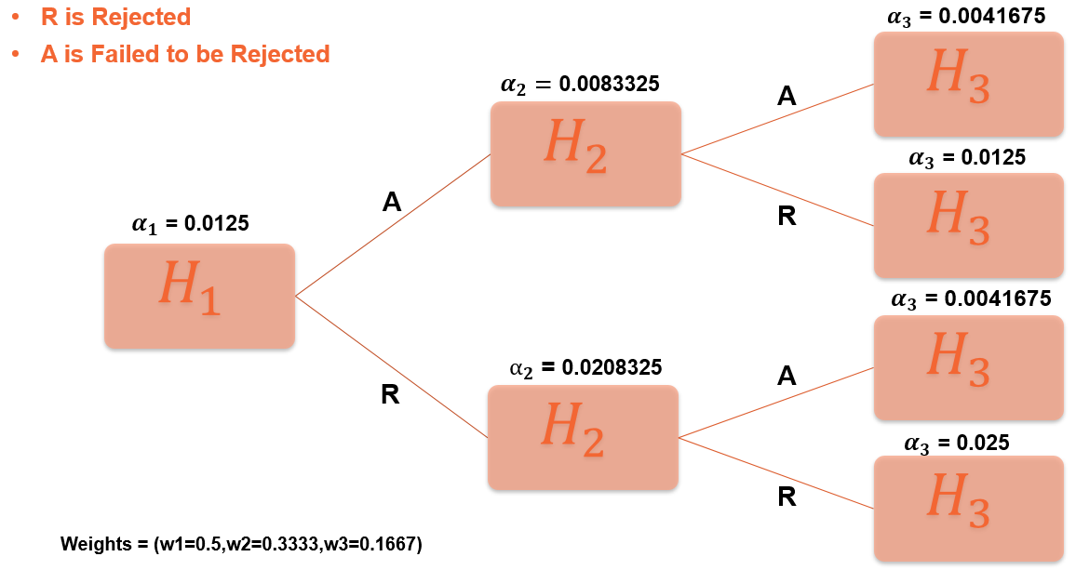
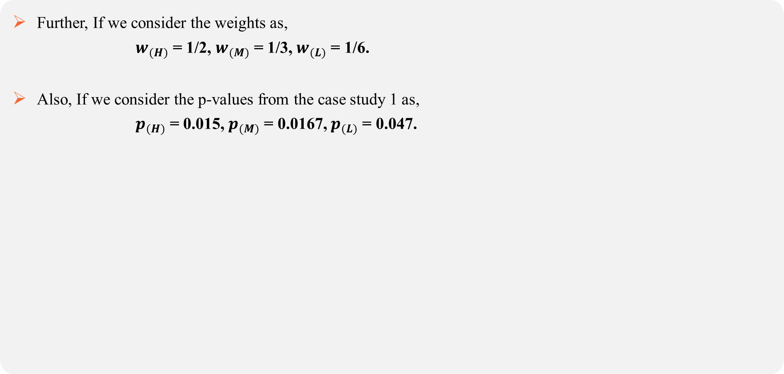
Considering Fixed Sequence and Fallback Procedures using same case study
Further, If we consider the weights as,
$w_{(H)}$ = 1/2, $w_{(M)}$ = 1/3, $w_{(L)}$ = 1/6.
Also, If we consider the p-values from the case study 1 as,
$p_{(H)}$ = 0.015, $p_{(M)}$ = 0.0167, $p_{(L)}$ = 0.047.
Fallback Procedure
Fixed Sequence

Slide 13
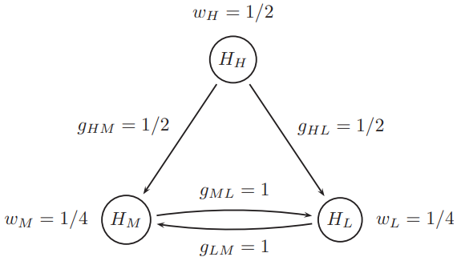
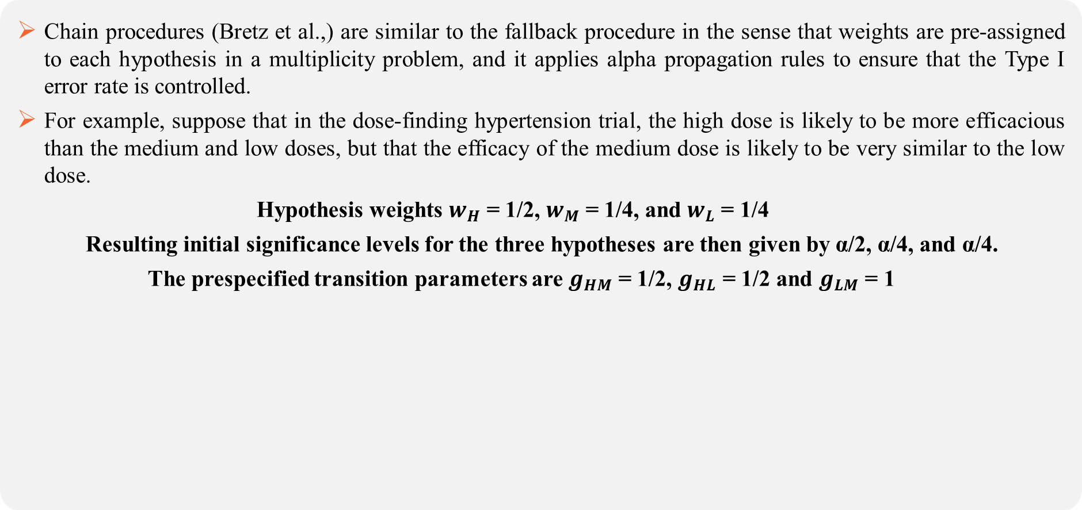
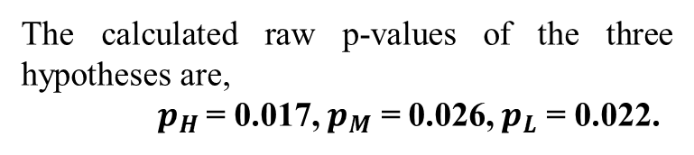
Chain based Graphical Procedure
Chain procedures (Bretz et al.,) are similar to the fallback procedure in the sense that weights are pre-assigned to each hypothesis in a multiplicity problem, and it applies alpha propagation rules to ensure that the Type I error rate is controlled.
For example, suppose that in the dose-finding hypertension trial, the high dose is likely to be more efficacious than the medium and low doses, but that the efficacy of the medium dose is likely to be very similar to the low dose.
Hypothesis weights $w_{H}$ = 1/2, $w_{M}$ = 1/4, and $w_{L}$ = 1/4
Resulting initial significance levels for the three hypotheses are then given by α/2, α/4, and α/4.
The prespecified transition parameters are $g_{HM}$ = 1/2, $g_{HL}$ = 1/2 and $g_{LM}$ = 1
The calculated raw p-values of the three hypotheses are,
$p_{H}$ = 0.017, $p_{M}$ = 0.026, $p_{L}$ = 0.022.

Slide 14
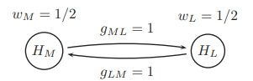
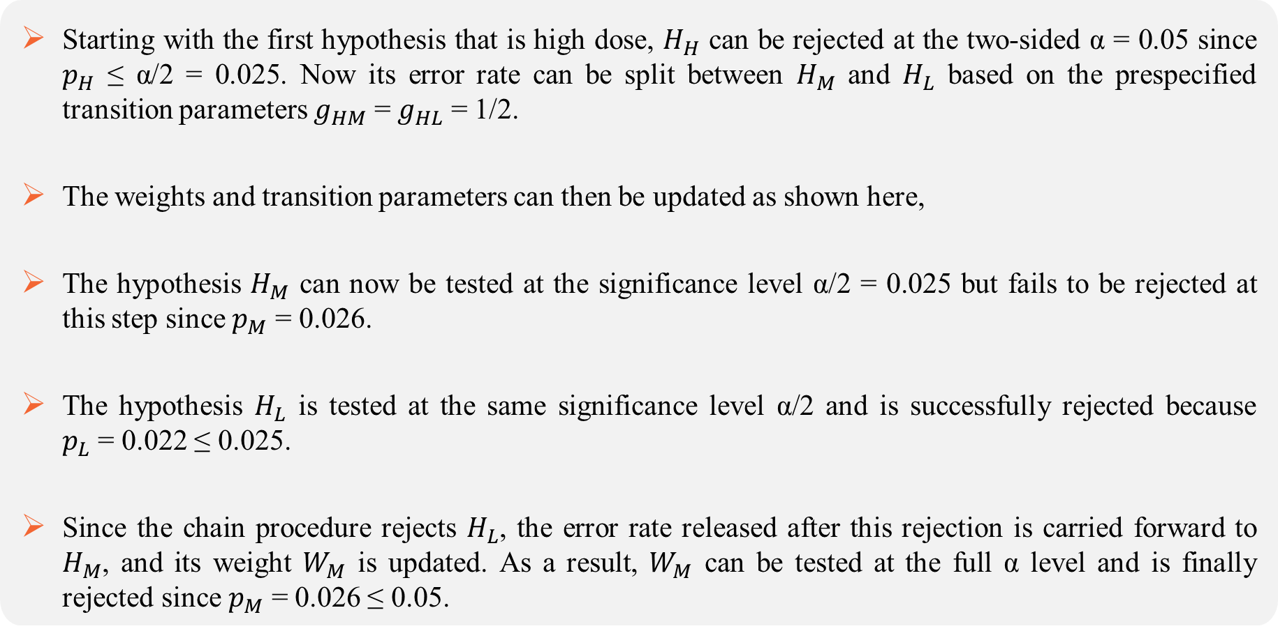
Starting with the first hypothesis that is high dose, $H_{H}$ can be rejected at the two-sided α = 0.05 since $p_{H}$ ≤ α/2 = 0.025. Now its error rate can be split between $H_{M}$ and $H_{L}$ based on the prespecified transition parameters $g_{HM}$ = $g_{HL}$ = 1/2.
The weights and transition parameters can then be updated as shown here,
The hypothesis $H_{M}$ can now be tested at the significance level α/2 = 0.025 but fails to be rejected at this step since $p_{M}$ = 0.026.
The hypothesis $H_{L}$ is tested at the same significance level α/2 and is successfully rejected because $p_{L}$ = 0.022 ≤ 0.025.
Since the chain procedure rejects $H_{L}$, the error rate released after this rejection is carried forward to $H_{M}$, and its weight $W_{M}$ is updated. As a result, $W_{M}$ can be tested at the full α level and is finally rejected since $p_{M}$ = 0.026 ≤ 0.05.

Slide 15
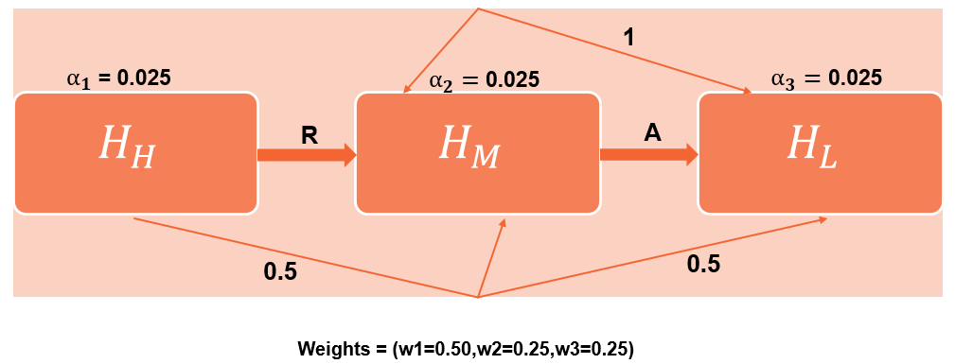
The calculated raw p-values of the three hypotheses are,
$p_{H}$ = 0.017, $p_{M}$ = 0.026, $p_{L}$ = 0.022.
Chain Procedure

Slide 16
Gatekeeping Procedures
In this method, null hypotheses are grouped into families that are tested in a sequential manner in the sense that the acceptance or rejection of null hypotheses in a particular family depends on the outcome of the significance tests carried out in the preceding families.
Any procedure that provides local error rate control can be considered as component procedures, including the Bonferroni, Holm, Hochberg, Hommel, or other procedures.
Another important condition is that the component procedures in primary family need to be “separable”.
Several types of gatekeeping procedures for hierarchically ordered families of hypotheses have been proposed which are,
Serial Gatekeeping
Parallel Gatekeeping
Multi-Sequence Gatekeeping

Slide 17
Serial and Parallel Gatekeeping Procedures
A serial gatekeeping strategy can be applied, for example the end points of primary family are tested as co-primary end points, if all endpoints in the primary family are statistically significant at the alpha level (e.g., α = 0.05), the endpoints in the second family are examined.
A parallel gatekeeping strategy is applied when the endpoints in the primary family are not all co-primary endpoints but are multiple end points, and a separable testing method (e.g., Bonferroni method or Holm method) is specified for the primary family. In this strategy, the second endpoint family is examined when at least one of the endpoints in the first family has shown statistical significance.

Slide 18
Example of Type 2 diabetes mellitus trial
Objective:
Evaluate the efficacy and safety of saxagliptin in patients with Type 2 diabetes mellitus.
Primary endpoint:
Change from baseline to Week 24 in HbA1c.
Families of dose-placebo comparisons:
Primary family: Saxagliptin 2.5 mg q.A.M. versus placebo, Saxagliptin 5 mg q.A.M. versus placebo.
Secondary family: Saxagliptin 2.5/5 mg q.A.M. versus placebo.
Family 1: Truncated Hochberg procedure with γ = 0.7
Family 2: Univariate test

Slide 19
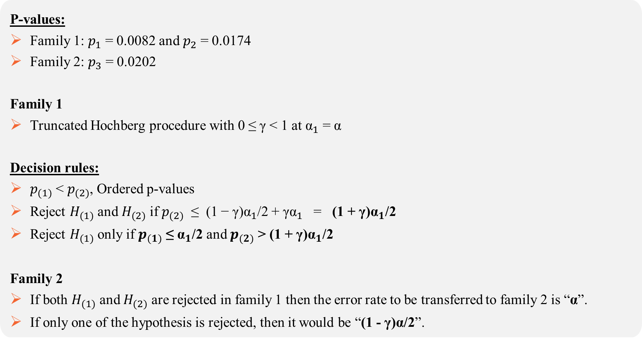
P-values:
Family 1: $p_{1}$ = 0.0082 and $p_{2}$ = 0.0174
Family 2: $p_{3}$ = 0.0202
Family 1
Truncated Hochberg procedure with 0 ≤ γ < 1 at ${\text{α}}_{1}$ = α
Decision rules:
$p_{(1)}$ < $p_{(2)}$, Ordered p-values
Reject $H_{(1)}$ and $H_{(2)}$ if $p_{(2)}$ ≤ (1 − γ)${\text{α}}_{1}$/2 + γ${\text{α}}_{1}$ = (1 + γ)${\text{α}}_{1}$/2
Reject $H_{(1)}$ only if $p_{(1)}$ ≤ ${\text{α}}_{1}$/2 and $p_{(2)}$ > (1 + γ)${\text{α}}_{1}$/2
Family 2
If both $H_{(1)}$ and $H_{(2)}$ are rejected in family 1 then the error rate to be transferred to family 2 is “α”.
If only one of the hypothesis is rejected, then it would be “(1 - γ)α/2”.

Slide 20
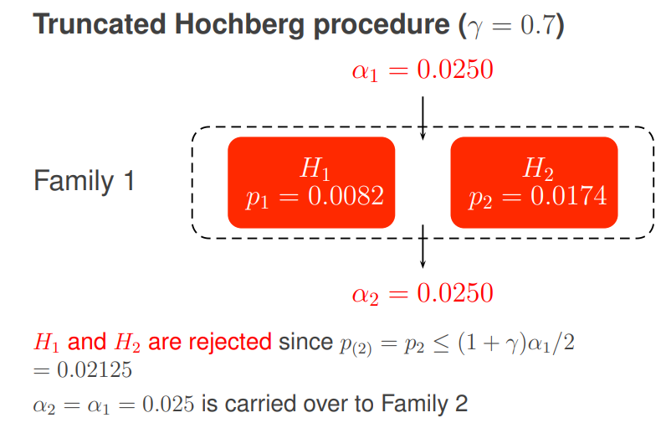
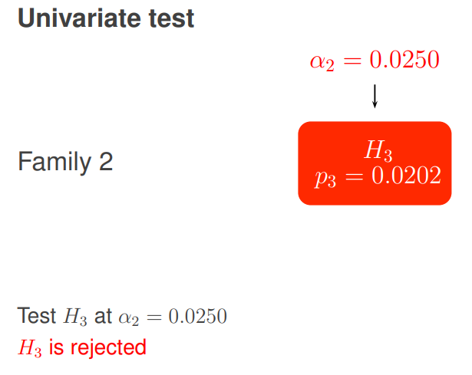
Graphs of Serial and Parallel Gatekeeping Procedures

Slide 21
Multi-Sequence Gatekeeping Procedure
In the multi-sequence gatekeeping procedure, the testing of hypotheses is organized into multiple sequences, each represents a distinct set of related hypotheses. This approach allows for branching, where the testing can proceed along different sequences based on the rejection or acceptance of hypotheses at each step.
Example of Schizophrenia trial:
Objective:
Evaluate the short-term efficacy and safety of lurasidone in the treatment of acute schizophrenia.
Trial arms
Two doses of lurasidone (40 mg and 120 mg) versus placebo.
Primary endpoint
Endpoint P: Change from baseline to Week 6 in PANSS (Positive and Negative Syndrome Scale) total score.
Secondary endpoint
Endpoint S: Change from baseline to Week 6 in CGI-S (Clinical Global Impressions – Severity) score.

Slide 22
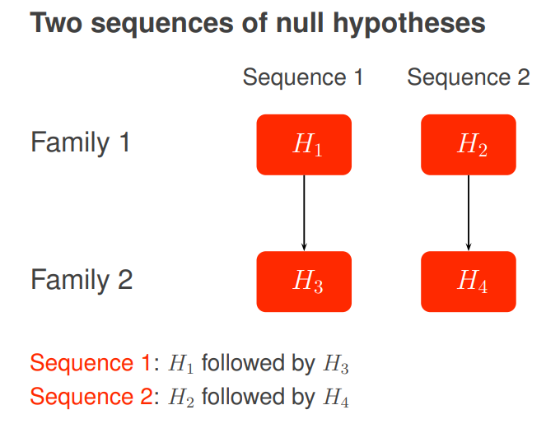
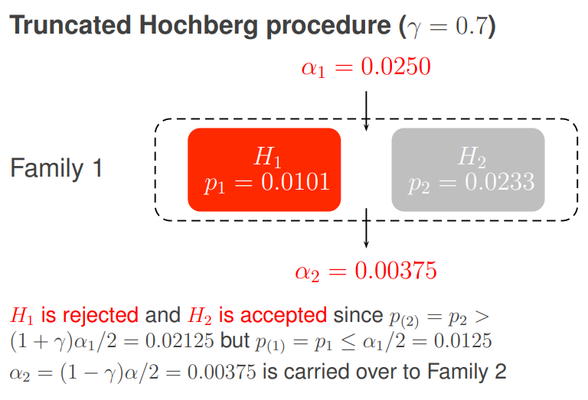
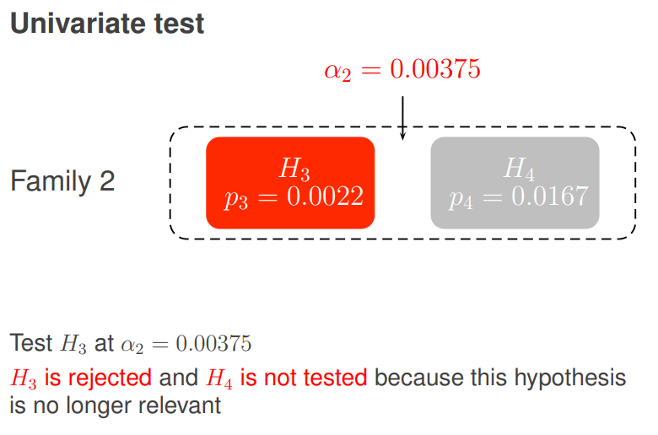

Slide 23
Simulation Study

Slide 24
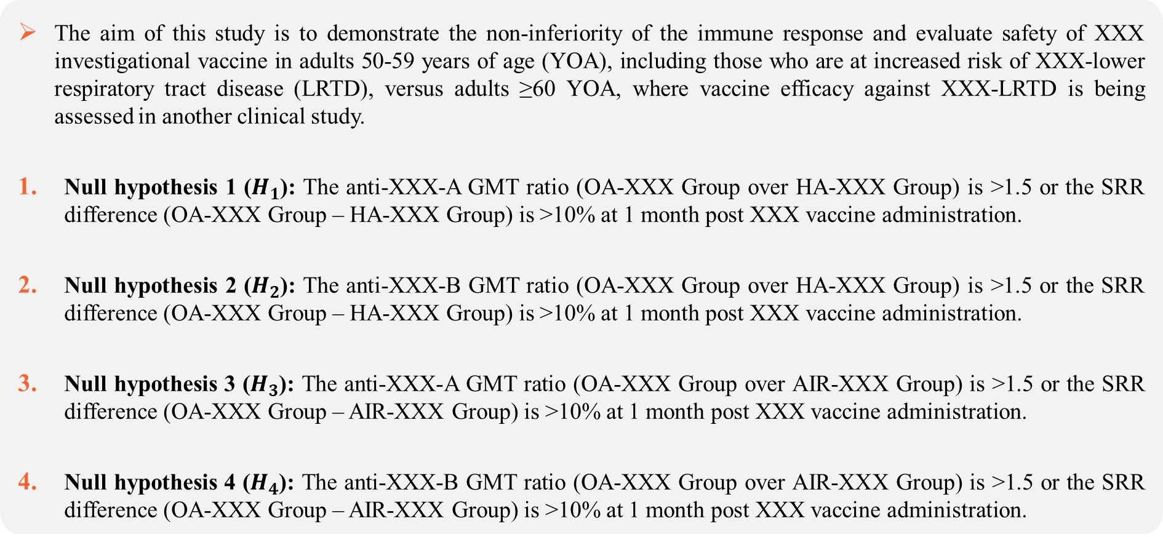
Objective
The aim of this study is to demonstrate the non-inferiority of the immune response and evaluate safety of XXX investigational vaccine in adults 50-59 years of age (YOA), including those who are at increased risk of XXX-lower respiratory tract disease (LRTD), versus adults ≥60 YOA, where vaccine efficacy against XXX-LRTD is being assessed in another clinical study.
Null hypothesis 1 ($H_{1}$): The anti-XXX-A GMT ratio (OA-XXX Group over HA-XXX Group) is >1.5 or the SRR difference (OA-XXX Group – HA-XXX Group) is >10% at 1 month post XXX vaccine administration.
Null hypothesis 2 ($H_{2}$): The anti-XXX-B GMT ratio (OA-XXX Group over HA-XXX Group) is >1.5 or the SRR difference (OA-XXX Group – HA-XXX Group) is >10% at 1 month post XXX vaccine administration.
Null hypothesis 3 ($H_{3}$): The anti-XXX-A GMT ratio (OA-XXX Group over AIR-XXX Group) is >1.5 or the SRR difference (OA-XXX Group – AIR-XXX Group) is >10% at 1 month post XXX vaccine administration.
Null hypothesis 4 ($H_{4}$): The anti-XXX-B GMT ratio (OA-XXX Group over AIR-XXX Group) is >1.5 or the SRR difference (OA-XXX Group – AIR-XXX Group) is >10% at 1 month post XXX vaccine administration.

Slide 25
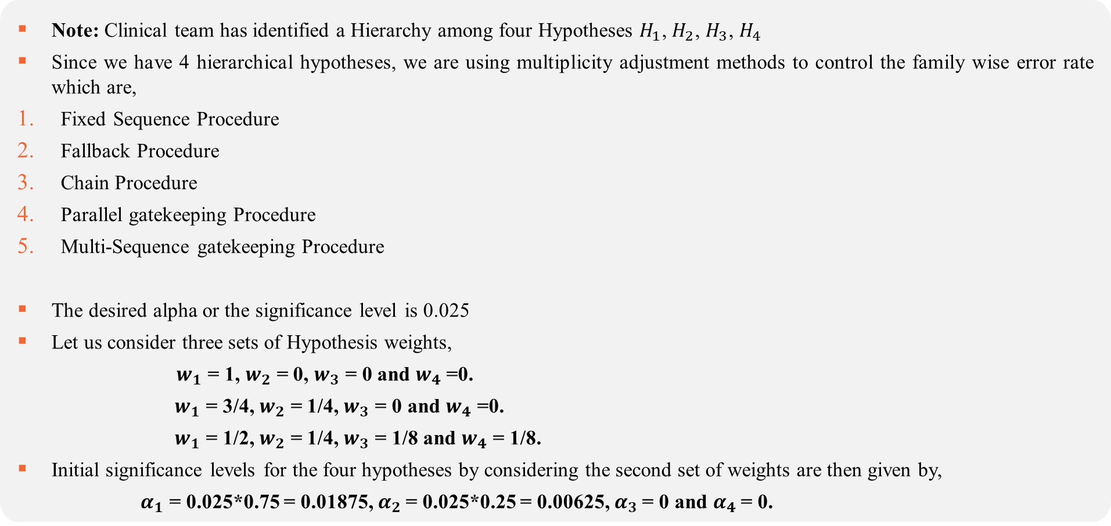
Multiplicity Procedures
Note: Clinical team has identified a Hierarchy among four Hypotheses $H_{1}$, $H_{2}$, $H_{3}$, $H_{4}$
Since we have 4 hierarchical hypotheses, we are using multiplicity adjustment methods to control the family wise error rate which are,
Fixed Sequence Procedure
Fallback Procedure
Chain Procedure
Parallel gatekeeping Procedure
Multi-Sequence gatekeeping Procedure
The desired alpha or the significance level is 0.025
Let us consider three sets of Hypothesis weights,
$w_{1}$ = 1, $w_{2}$ = 0, $w_{3}$ = 0 and $w_{4}$=0.
$w_{1}$ = 3/4, $w_{2}$ = 1/4, $w_{3}$ = 0 and $w_{4}$ =0.
$w_{1}$ = 1/2, $w_{2}$ = 1/4, $w_{3}$ = 1/8 and $w_{4}$ = 1/8.
Initial significance levels for the four hypotheses by considering the second set of weights are then given by,
$α_{1}$ = 0.025*0.75 = 0.01875, $α_{2}$= 0.025*0.25 = 0.00625, $α_{3}$= 0 and $α_{4}$= 0.

Slide 26
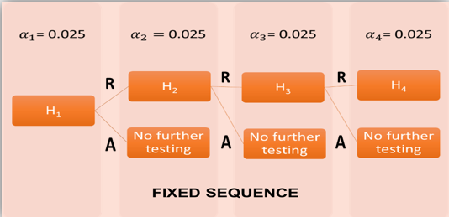
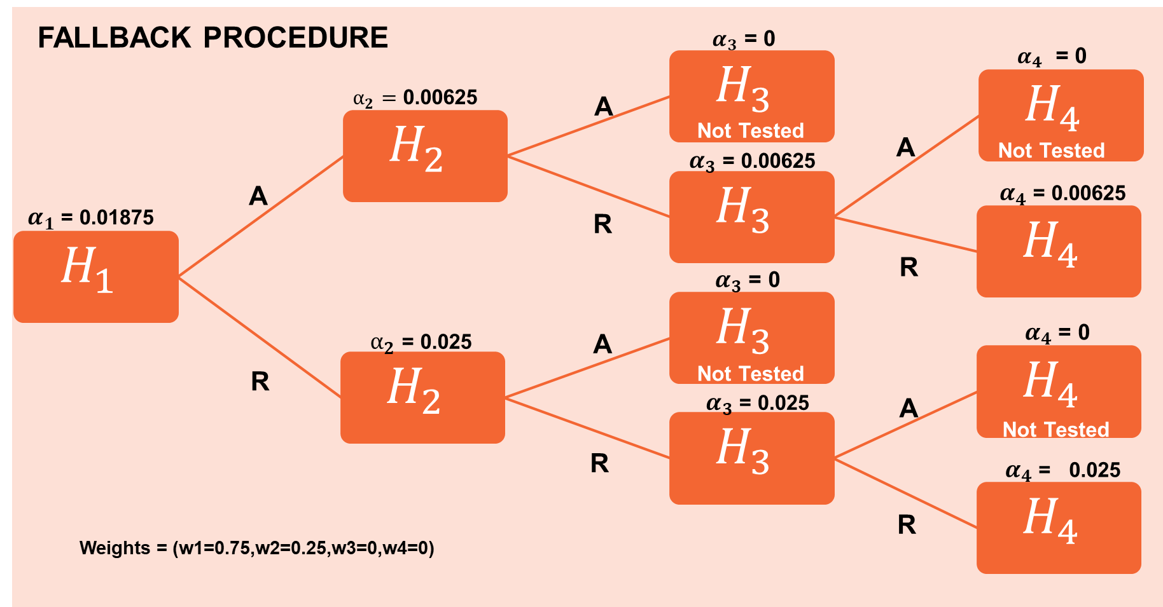
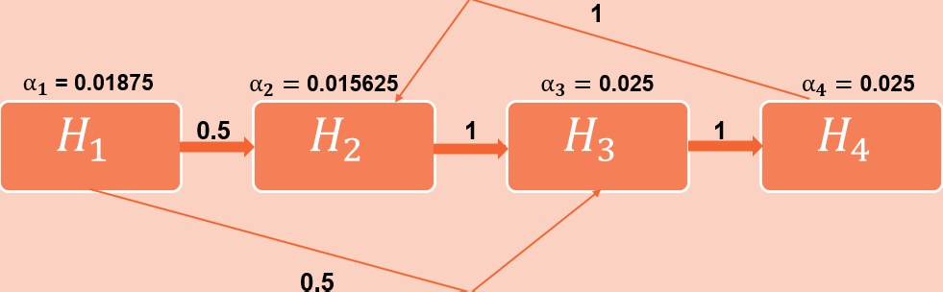
How these Hierarchical Procedures Works?
Chain Procedure

Slide 27
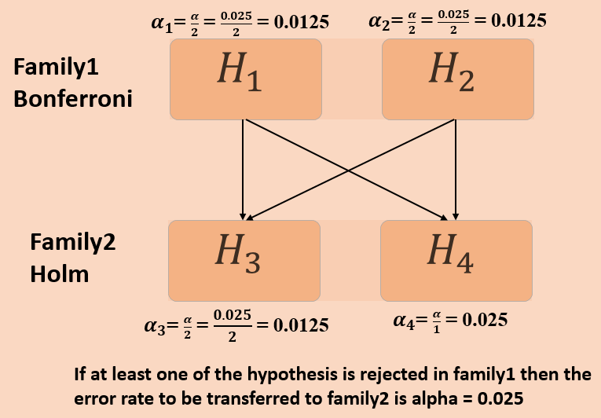
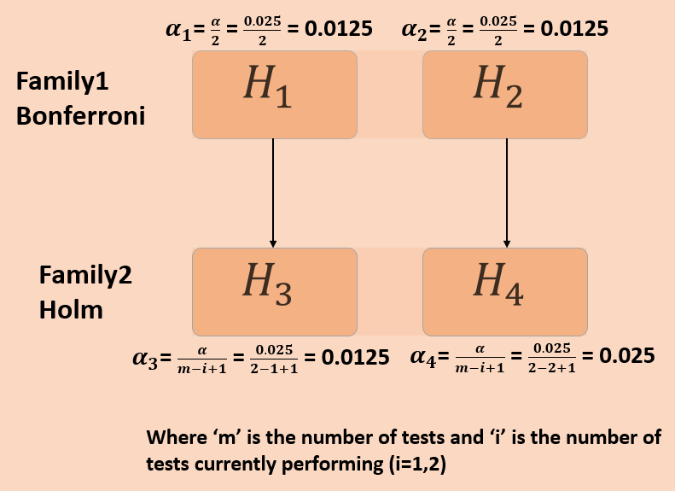
Parallel gatekeeping Procedure
Multi-Sequence gatekeeping Procedure

Slide 28
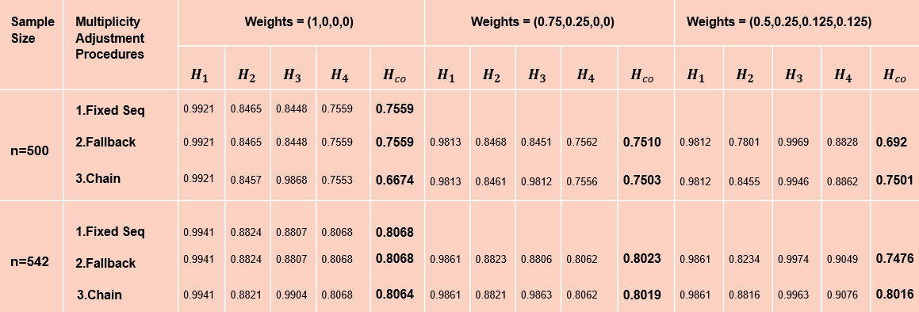
Simulation Results
Result 1

Slide 29
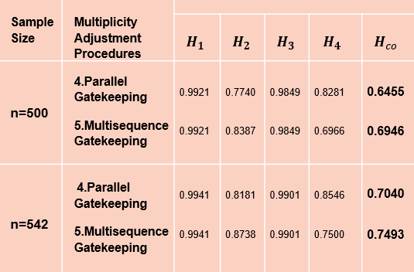
Result 2

Slide 30
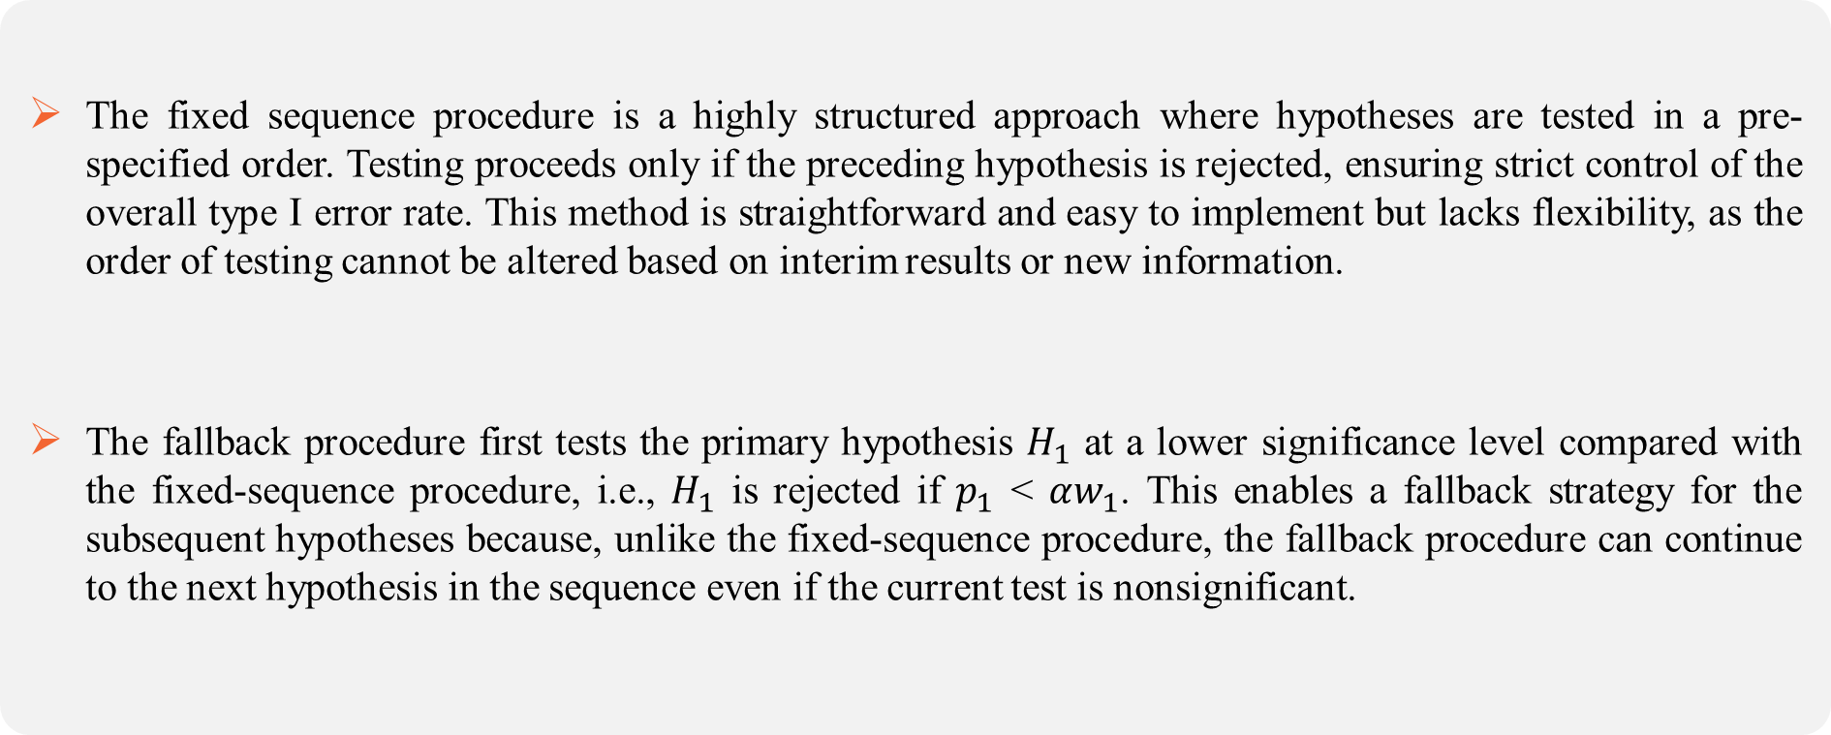
Key takeaways
The fixed sequence procedure is a highly structured approach where hypotheses are tested in a pre-specified order. Testing proceeds only if the preceding hypothesis is rejected, ensuring strict control of the overall type I error rate. This method is straightforward and easy to implement but lacks flexibility, as the order of testing cannot be altered based on interim results or new information.
The fallback procedure first tests the primary hypothesis $H_{1}$ at a lower significance level compared with the fixed-sequence procedure, i.e., $H_{1}$ is rejected if $p_{1}$ < $αw_{1}$. This enables a fallback strategy for the subsequent hypotheses because, unlike the fixed-sequence procedure, the fallback procedure can continue to the next hypothesis in the sequence even if the current test is nonsignificant.

Slide 31
The main difference with the fallback procedure lies in the fact that chain procedures support more flexible alpha propagation rules, e.g., after each rejection, the error rate can be transferred simultaneously to several hypotheses. By using flexible alpha propagation rules, the trial's sponsor can set up more complex decision trees that go beyond a single sequence of hypotheses.
The parallel gatekeeping procedure allows for more flexibility by testing hypotheses in multiple families simultaneously. This approach is useful when hypotheses across different families are not interdependent and can be tested concurrently. It provides a less restrictive framework compared to the serial procedure while still controlling the overall Type I error rate.

Slide 32
However, unlike the serial procedure, the multi-sequence approach allows for branching, where the testing can proceed along different sequences based on the rejection or acceptance of hypotheses at each step. This flexibility makes it suitable for complex testing scenarios where hypotheses may have different dependencies and hierarchical structures.
The interpretation of our results highlights the significance of accounting for both sample size and hypothesis weights when selecting an appropriate hierarchical multiple testing procedure.
We gain understanding of how different hierarchical methods respond to different experimental conditions. Such insights can inform researchers decision-making processes, guiding the selection of the most suitable approach for their specific research objectives.

Slide 34
Types of Clinical Endpoints
In clinical trials, multiple endpoints refer to the various outcomes that researchers assess to determine the effect of a particular intervention, such as a drug or treatment. These endpoints can provide a comprehensive understanding of the impact on different aspects of a disease.
Primary Endpoints: These are the main outcomes that the study aims to determine the overall effectiveness of the intervention. The primary endpoint is often the most clinically important outcome for the study.
Secondary Endpoints: These are additional outcomes that are of interest but may not be as critical as the primary endpoint. Secondary endpoints provide supplementary information about the intervention's impact on various aspects of health, safety, or other relevant factors.

Slide 35
when there are multiple primary endpoints, and each endpoint could be sufficient on its own to establish the drug’s efficacy. These multiple endpoints thus correspond to multiple chances of success, and in this case, failure to adjust for multiplicity can lead to Type I error rate inflation and a false conclusion that the drug is effective.
Cancer Trials: In oncology trials, multiple primary endpoints could include overall survival, progression-free survival, and tumor response rate.
Diabetes Trials: Clinical trials in diabetes management might have multiple primary endpoints such as glycemic control (e.g., HbA1c levels), reducing the risk of kidney failure, and cardiovascular outcomes.
Co-primary endpoints are multiple endpoints in a clinical trial that are considered equally important for evaluating the efficacy or effectiveness of an intervention.
Co-primary endpoints carry equal weight in determining the success or failure of the trial.
Therapies for the acute treatment of migraine headaches illustrate this circumstance. Although pain is the most prominent feature, migraine headaches are also characterized by the presence of photophobia, phonophobia, and/or nausea, all of which are clinically important.
Multiple Primary end points
Co-Primary end points

Slide 36
Composite end points
There are some disorders for which more than one clinical outcome in a clinical trial is important, and all outcomes are expected to be affected by the treatment.
Rather than using each as a separate primary endpoint (creating multiplicity) or selecting just one to be the primary endpoint and designating the others as secondary endpoints, it could be appropriate to combine those clinical outcomes into a single variable. This is often called a “composite endpoint”.
For example, in many cardiovascular studies it is usual to combine several endpoints (e.g., cardiovascular death, heart attack, and stroke) into a single composite endpoint that is primary and to consider death a secondary endpoint.

Slide 37
What are Single-Step Procedures?
Single-step procedures, also known as simultaneous inference procedures, are statistical methods used to conduct multiple comparisons or tests simultaneously while controlling the overall error rate. These procedures are often employed after performing an overall statistical test (e.g., ANOVA) to determine if there are significant differences among groups. If the overall test is significant, single-step procedures allow for comparisons between individual groups to identify which pairs are significantly different from each other.
There are various methods in Single-Step Procedures which includes,
Bonferroni Correction (Non-Parametric)
Sidak (Non-parametric)
Dunnet (Parametric)

Slide 38
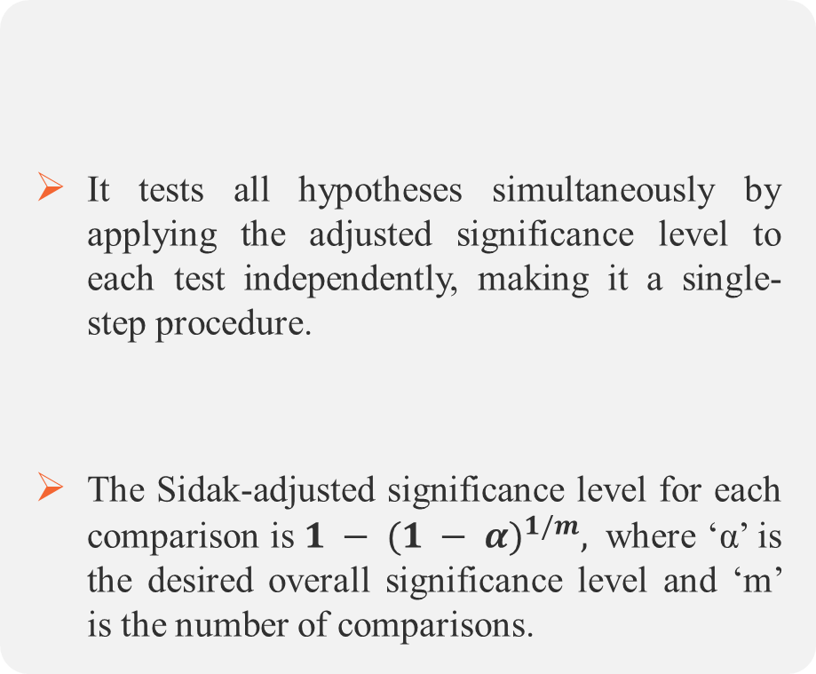
Single-step Procedures
Bonferroni correction adjusts the significance level for each individual test to maintain the overall family-wise error rate. Each hypothesis is tested at this adjusted significance level independently, making it a single-step procedure.
This adjusted significance level, often denoted as α/m, is then used for each individual comparison.
It tests all hypotheses simultaneously by applying the adjusted significance level to each test independently, making it a single-step procedure.
The Sidak-adjusted significance level for each comparison is ${1 − (1 − α)}^{1/m},$ where ‘α’ is the desired overall significance level and ‘m’ is the number of comparisons.
Bonferroni Procedure
Sidak Procedure

Slide 39
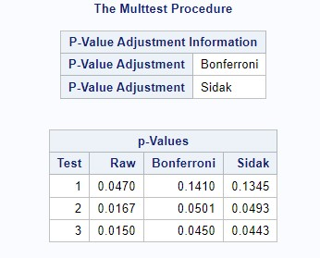

Example: Case Study (Dose finding hypertension trial)
Suppose that a dose-finding trial has been conducted to compare low, medium, and high doses of a new antihypertensive drug (labeled L, M, and H) to placebo (labeled P). The primary efficacy variable is diastolic blood pressure.
Let $μ_{P}$ denote the mean reduction in diastolic blood pressure in the placebo group. Similarly, $μ_{L}$, $μ_{M}$, and $μ_{H}$ denote the mean reduction in diastolic blood pressure in the low, medium, and high dose groups, respectively.
The following null hypotheses are tested in the trial:
$H_{L}$ = {$μ_{P}$ − $μ_{L}$ ≤ δ}
$H_{M}$ = {$μ_{P}$ − $μ_{M}$ ≤ δ}
$H_{H}$ = {$μ_{P}$ − $μ_{H}$ ≤ δ}
Suppose if the p-values of all the three hypotheses are,
$p_{L}$ = 0.047
$p_{M}$ = 0.0167
$p_{H}$ = 0.015

Slide 40
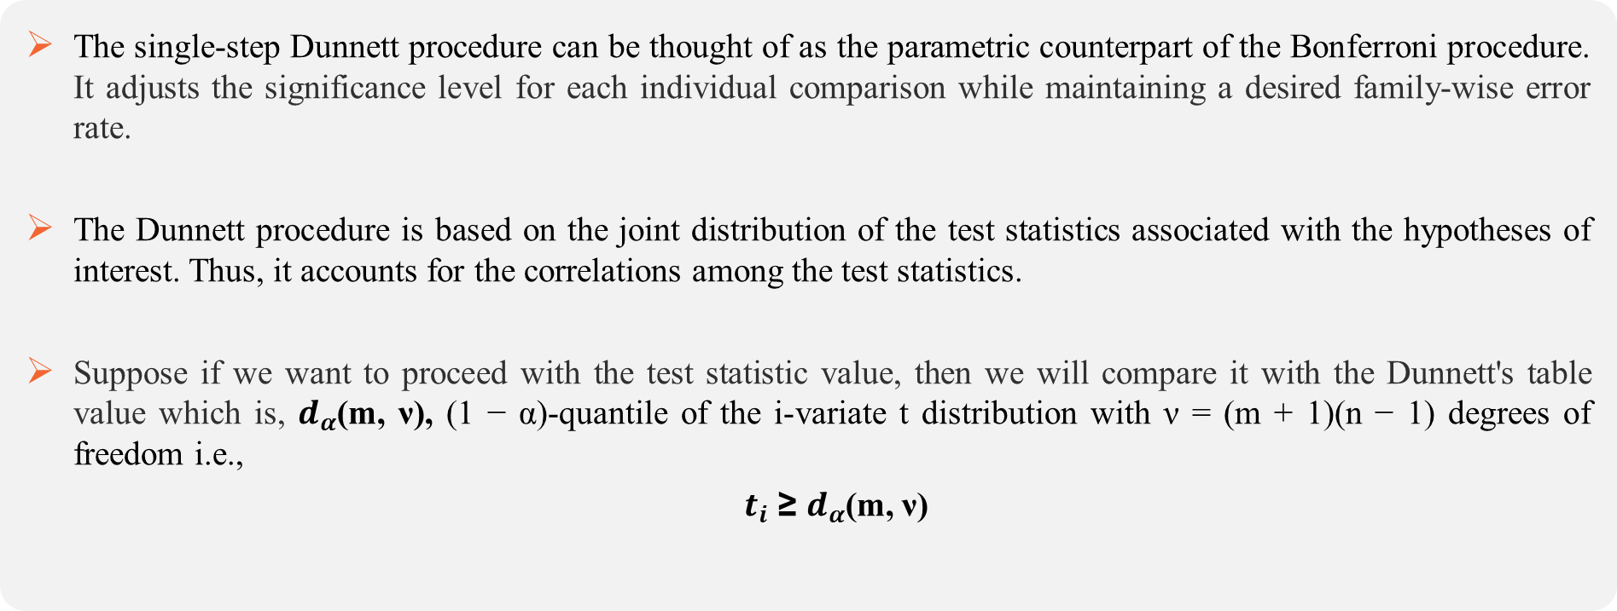
Dunnett Procedure
The single-step Dunnett procedure can be thought of as the parametric counterpart of the Bonferroni procedure. It adjusts the significance level for each individual comparison while maintaining a desired family-wise error rate.
The Dunnett procedure is based on the joint distribution of the test statistics associated with the hypotheses of interest. Thus, it accounts for the correlations among the test statistics.
Suppose if we want to proceed with the test statistic value, then we will compare it with the Dunnett's table value which is, $d_{α}$(m, ν), (1 − α)-quantile of the i-variate t distribution with ν = (m + 1)(n − 1) degrees of freedom i.e.,
$t_{i}$ ≥ $d_{α}$(m, ν)

Slide 41
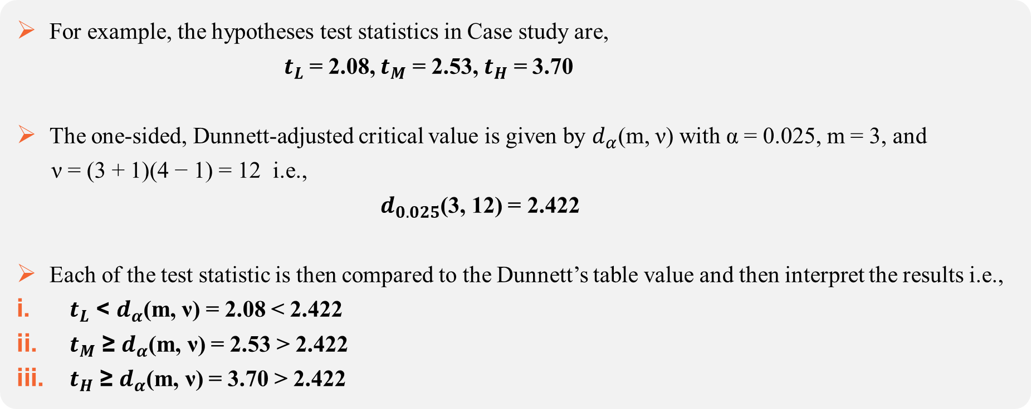
Example of the same case study
For example, the hypotheses test statistics in Case study are,
$t_{L}$ = 2.08, $t_{M}$ = 2.53, $t_{H}$ = 3.70
The one-sided, Dunnett-adjusted critical value is given by $d_{α}$(m, ν) with α = 0.025, m = 3, and
ν = (3 + 1)(4 − 1) = 12 i.e.,
$d_{0.025}$(3, 12) = 2.422
Each of the test statistic is then compared to the Dunnett’s table value and then interpret the results i.e.,
$t_{L}$ < $d_{α}$(m, ν) = 2.08 < 2.422
$t_{M}$ ≥ $d_{α}$(m, ν) = 2.53 > 2.422
$t_{H}$ ≥ $d_{α}$(m, ν) = 3.70 > 2.422

Slide 42
What are Data-driven hypotheses ordering Procedures?
The Procedures with a data-driven hypothesis ordering will introduce MTPs that test the null hypotheses in a stepwise manner.
Data-driven hypothesis ordering means arranging hypotheses based on what the data shows rather than deciding the order of hypotheses before analyzing the data.
There are various methods in Data-Driven hypothesis ordering which includes,
Holm’s method (Non-Parametric)
Hochberg (semi-parametric)
Hommel (semi-parametric)
Step up Dunnett (Parametric)
Step down Dunnett (Parametric)

Slide 43
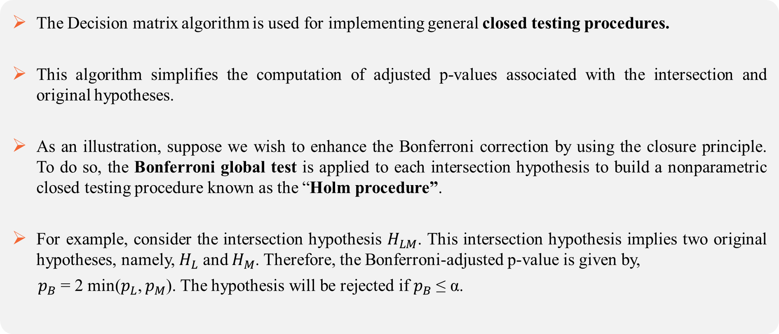
Holm Procedure Using Decision Matrix Algorithm
The Decision matrix algorithm is used for implementing general closed testing procedures.
This algorithm simplifies the computation of adjusted p-values associated with the intersection and original hypotheses.
As an illustration, suppose we wish to enhance the Bonferroni correction by using the closure principle. To do so, the Bonferroni global test is applied to each intersection hypothesis to build a nonparametric closed testing procedure known as the “Holm procedure”.
For example, consider the intersection hypothesis $H_{LM}$. This intersection hypothesis implies two original hypotheses, namely, $H_{L}$ and $H_{M}$. Therefore, the Bonferroni-adjusted p-value is given by,
$p_{B}$ = 2 min($p_{L}$, $p_{M}$). The hypothesis will be rejected if $p_{B}$ ≤ α.

Slide 44
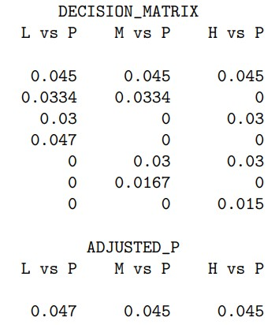
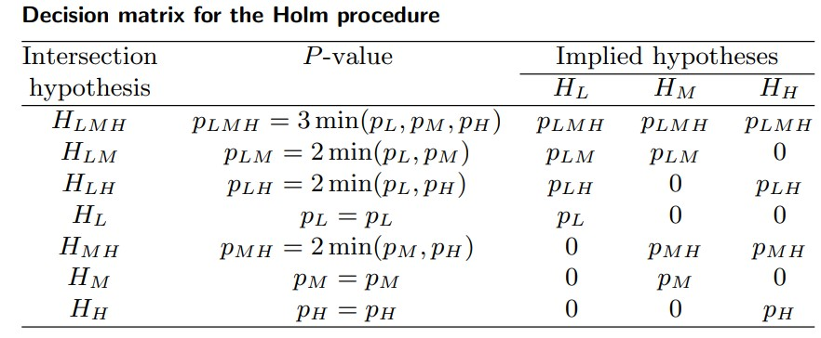
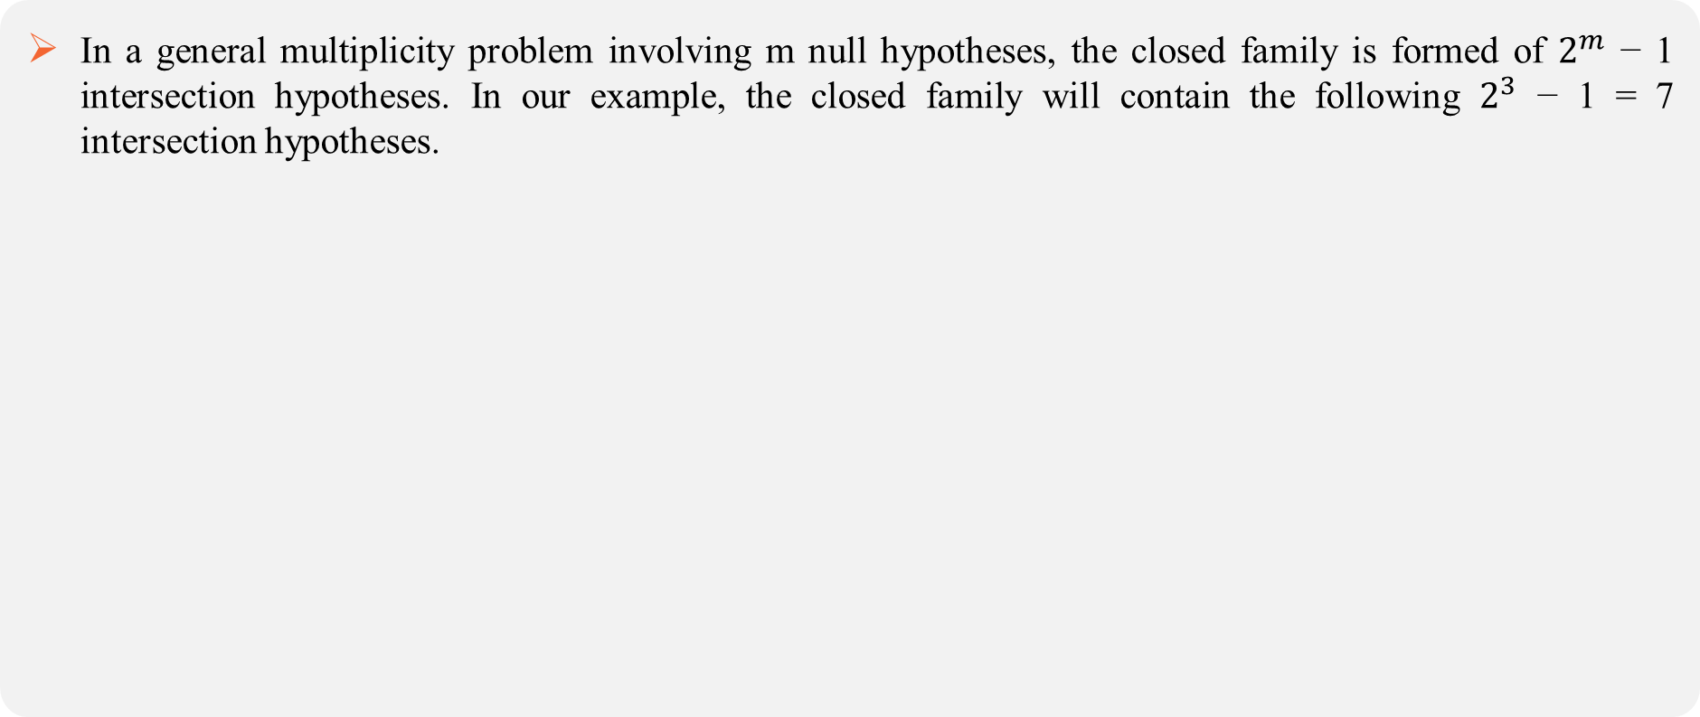
Example using same case study
In a general multiplicity problem involving m null hypotheses, the closed family is formed of $2^{m}$ − 1 intersection hypotheses. In our example, the closed family will contain the following $2^{3}$ − 1 = 7 intersection hypotheses.

Slide 45
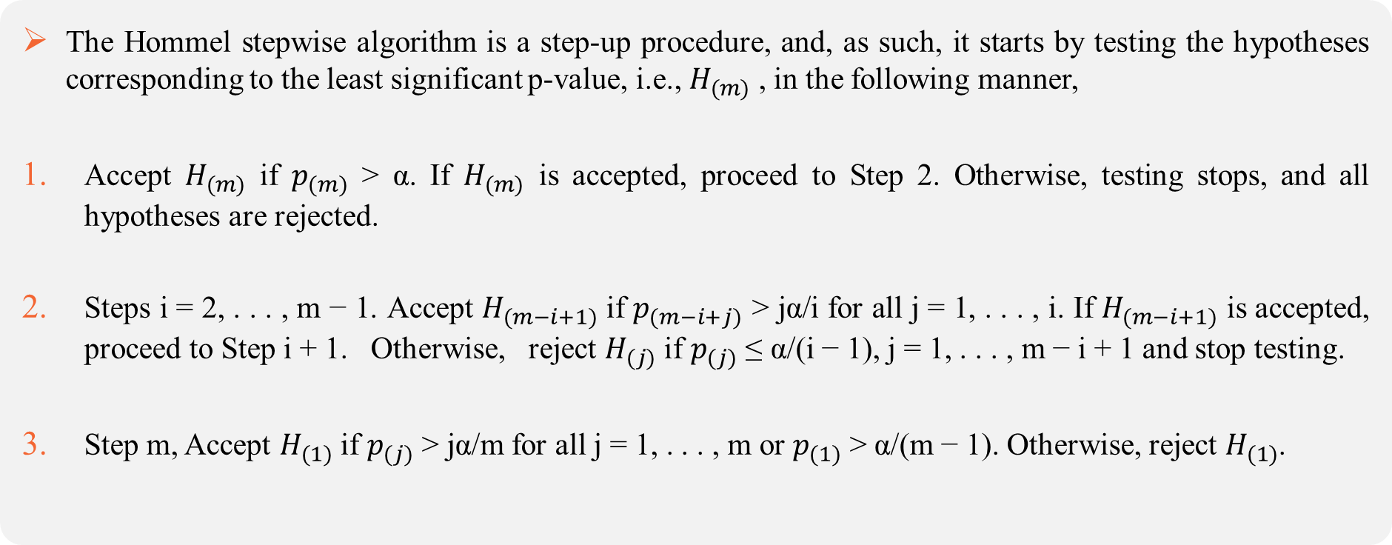
Hommel Step-up Procedure
The Hommel stepwise algorithm is a step-up procedure, and, as such, it starts by testing the hypotheses corresponding to the least significant p-value, i.e., $H_{(m)}$ , in the following manner,
Accept $H_{(m)}$ if $p_{(m)}$ > α. If $H_{(m)}$ is accepted, proceed to Step 2. Otherwise, testing stops, and all hypotheses are rejected.
Steps i = 2, . . . , m − 1. Accept $H_{(m−i+1)}$ if $p_{(m−i+j)}$ > jα/i for all j = 1, . . . , i. If $H_{(m−i+1)}$ is accepted, proceed to Step i + 1. Otherwise, reject $H_{(j)}$ if $p_{(j)}$ ≤ α/(i − 1), j = 1, . . . , m − i + 1 and stop testing.
Step m, Accept $H_{(1)}$ if $p_{(j)}$ > jα/m for all j = 1, . . . , m or $p_{(1)}$ > α/(m − 1). Otherwise, reject $H_{(1)}$.

Slide 46
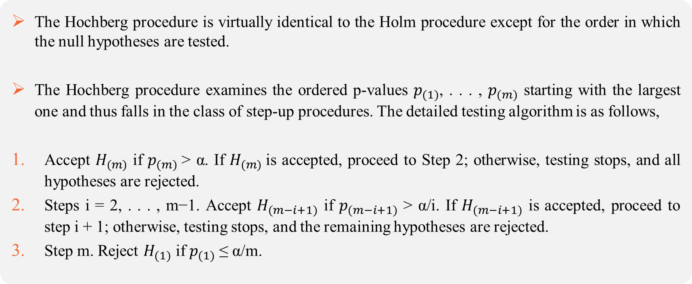
Hochberg Step-up Procedure
The Hochberg procedure is virtually identical to the Holm procedure except for the order in which the null hypotheses are tested.
The Hochberg procedure examines the ordered p-values $p_{(1)}$, . . . , $p_{(m)}$ starting with the largest one and thus falls in the class of step-up procedures. The detailed testing algorithm is as follows,
Accept $H_{(m)}$ if $p_{(m)}$> α. If $H_{(m)}$is accepted, proceed to Step 2; otherwise, testing stops, and all hypotheses are rejected.
Steps i = 2, . . . , m−1. Accept $H_{(m−i+1)}$ if $p_{(m−i+1)}$ > α/i. If $H_{(m−i+1)}$ is accepted, proceed to step i + 1; otherwise, testing stops, and the remaining hypotheses are rejected.
Step m. Reject $H_{(1)}$ if $p_{(1)}$ ≤ α/m.

Slide 47
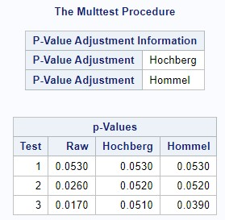
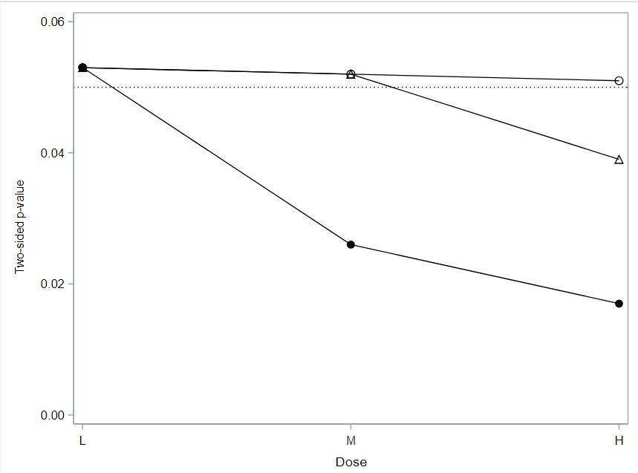
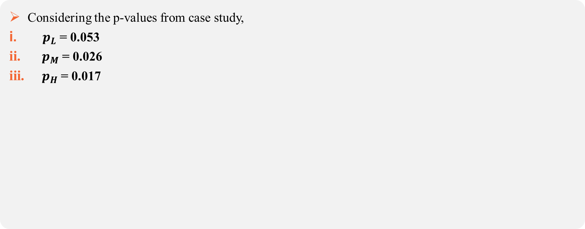
Hochberg and Hommel procedures considering same Case study
Considering the p-values from case study,
$p_{L}$ = 0.053
$p_{M}$ = 0.026
$p_{H}$ = 0.017

Slide 48
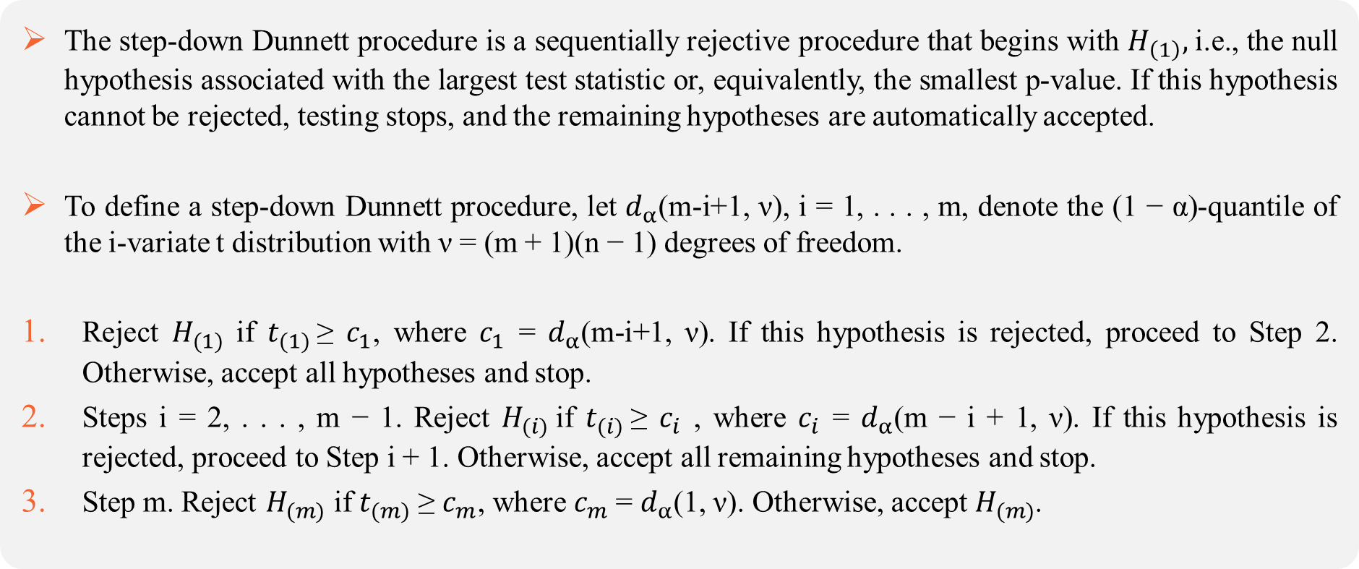
Step-down Dunnett Procedure
The step-down Dunnett procedure is a sequentially rejective procedure that begins with $H_{\left(1\right)},$i.e., the null hypothesis associated with the largest test statistic or, equivalently, the smallest p-value. If this hypothesis cannot be rejected, testing stops, and the remaining hypotheses are automatically accepted.
To define a step-down Dunnett procedure, let $d_{α}$(m-i+1, ν), i = 1, . . . , m, denote the (1 − α)-quantile of the i-variate t distribution with ν = (m + 1)(n − 1) degrees of freedom.
Reject $H_{(1)}$ if $t_{(1)}$≥ $c_{1}$, where $c_{1}$ = $d_{α}$(m-i+1, ν). If this hypothesis is rejected, proceed to Step 2. Otherwise, accept all hypotheses and stop.
Steps i = 2, . . . , m − 1. Reject $H_{(i)}$if $t_{(i)}$≥ $c_{i}$ , where $c_{i}$ = $d_{α}$(m − i + 1, ν). If this hypothesis is rejected, proceed to Step i + 1. Otherwise, accept all remaining hypotheses and stop.
Step m. Reject $H_{(m)}$ if $t_{(m)}$ ≥ $c_{m}$, where $c_{m}$= $d_{α}$(1, ν). Otherwise, accept $H_{(m)}$.

Slide 49
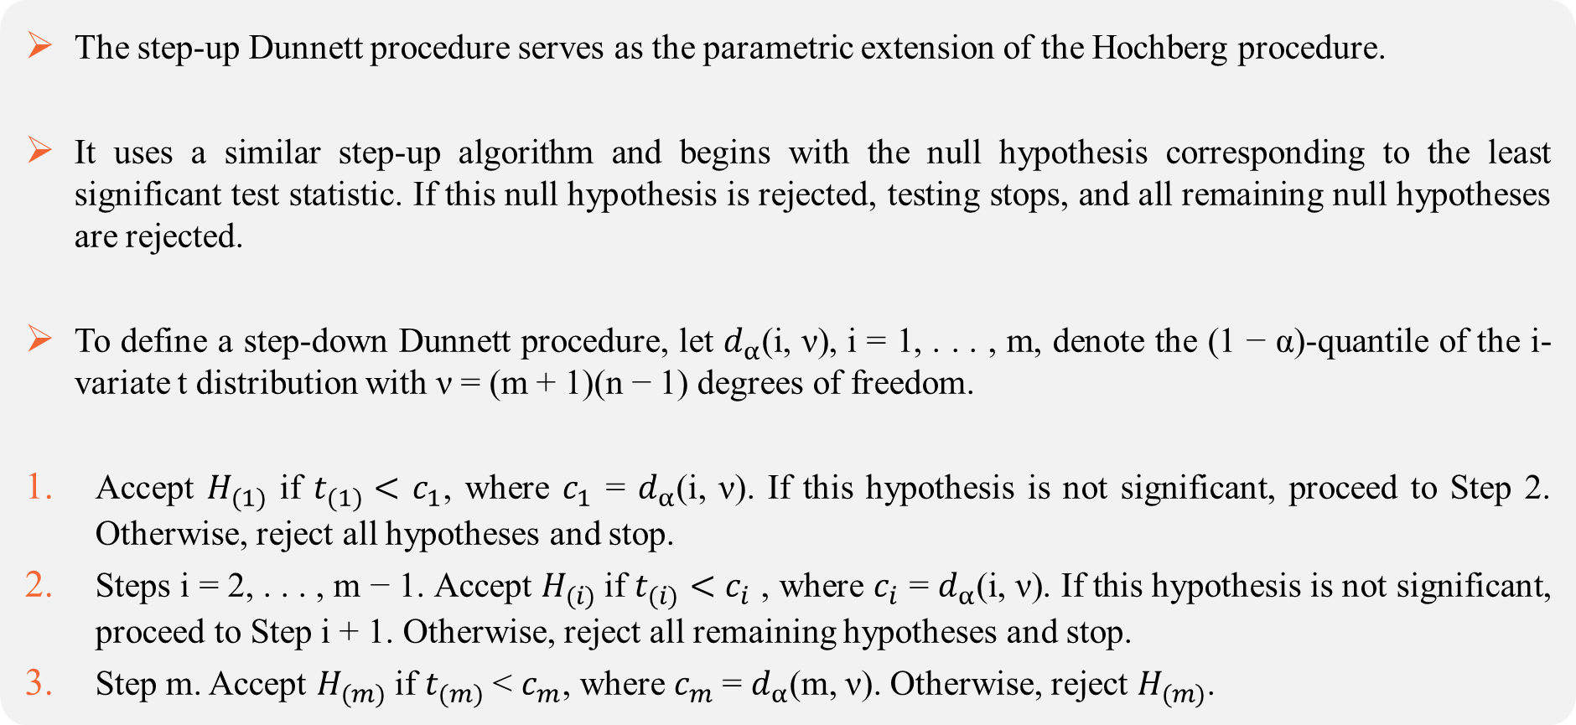
Step-up Dunnett Procedure
The step-up Dunnett procedure serves as the parametric extension of the Hochberg procedure.
It uses a similar step-up algorithm and begins with the null hypothesis corresponding to the least significant test statistic. If this null hypothesis is rejected, testing stops, and all remaining null hypotheses are rejected.
To define a step-down Dunnett procedure, let $d_{α}$(i, ν), i = 1, . . . , m, denote the (1 − α)-quantile of the i-variate t distribution with ν = (m + 1)(n − 1) degrees of freedom.
Accept $H_{(1)}$ if $t_{(1)}<$ $c_{1}$, where $c_{1}$ = $d_{α}$(i, ν). If this hypothesis is not significant, proceed to Step 2. Otherwise, reject all hypotheses and stop.
Steps i = 2, . . . , m − 1. Accept $H_{(i)}$if $t_{(i)}<$ $c_{i}$ , where $c_{i}$ = $d_{α}$(i, ν). If this hypothesis is not significant, proceed to Step i + 1. Otherwise, reject all remaining hypotheses and stop.
Step m. Accept $H_{(m)}$ if $t_{(m)}$ < $c_{m}$, where $c_{m}$= $d_{α}$(m, ν). Otherwise, reject $H_{(m)}$.

Slide 50
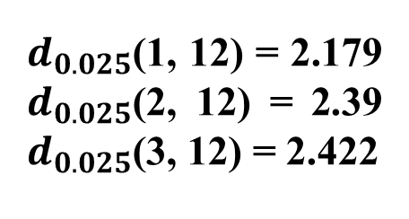
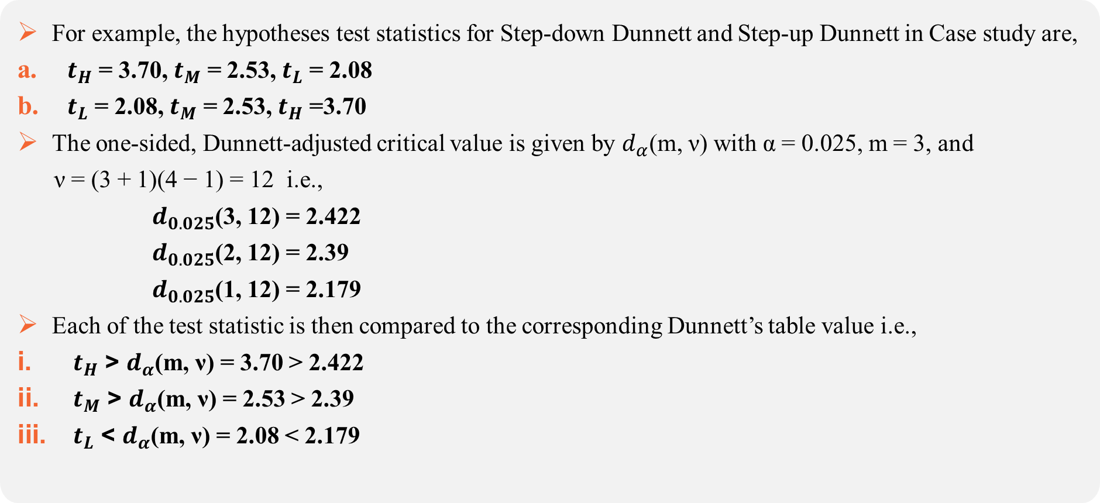
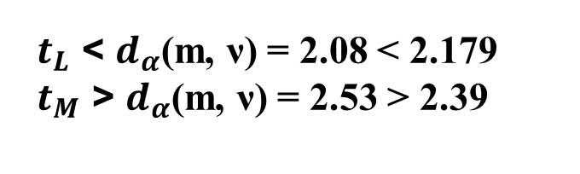
Example of Step-down and Step-up Dunnett using same case study
For example, the hypotheses test statistics for Step-down Dunnett and Step-up Dunnett in Case study are,
$t_{H}$ = 3.70, $t_{M}$ = 2.53, $t_{L}$ = 2.08
$t_{L}$ = 2.08, $t_{M}$ = 2.53, $t_{H}$ =3.70
The one-sided, Dunnett-adjusted critical value is given by $d_{α}$(m, ν) with α = 0.025, m = 3, and
ν = (3 + 1)(4 − 1) = 12 i.e.,
$d_{0.025}$(3, 12) = 2.422
$d_{0.025}$(2, 12) = 2.39
$d_{0.025}$(1, 12) = 2.179
Each of the test statistic is then compared to the corresponding Dunnett’s table value i.e.,
$t_{H}$ > $d_{α}$(m, ν) = 3.70 > 2.422
$t_{M}$ > $d_{α}$(m, ν) = 2.53 > 2.39
$t_{L}$ < $d_{α}$(m, ν) = 2.08 < 2.179
$d_{0.025}$(1, 12) = 2.179 $d_{0.025}$(2, 12) = 2.39 $d_{0.025}$(3, 12) = 2.422
$t_{L}$ < $d_{α}$(m, ν) = 2.08 < 2.179
$t_{M}$ > $d_{α}$(m, ν) = 2.53 > 2.39

